Slide 1
Good Afternoon!
Please sign in and have a seat.

Slide 2
Cumberland Valley 2012 District Arts Festival
Senior Exhibits: Information, Commitment, Execution, and restrictions

Slide 3
Information About Your Exhibition Space
You will be assigned a space in the dome to exhibit your work
Each exhibit is for a single artist, no groups
You are responsible for all materials that you use to design your space.
You may include props, furniture, etc. as long as you provide it from home…NO classroom furnishings
Think about your space as an extension of your work, unify the two together.
Viewer interaction is fine…unless you would prefer otherwise (Please Touch/Please DO NOT Touch)
Provide viewers a place to sign-in and comment on your work (a sketchbook)

Slide 4
Commitment
You must sign the attached SENIOR DISPLAY CONTRACT in order to be eligible for a space and return it at the meeting on April 18th.
You must be present for the evening showing on Thursday May 17th until 8pm.
You will need to attend all future DAF meetings as listed on your calendar and complete your display by Tuesday May 15th.

Slide 5
Exhibition Display: 2 Options
HOME
SCHOOL
Create your own display using all of your own materials and resources.
The display must fit into a 6x6 foot square area
The front and back of the display must be finished and presentable
Cardboard display
Square or triangular format
Can be painted with a SOLID COLOR or remain natural cardboard
You will need to supply the paint and painting supplies
Order 2 pieces of cardboard for your display

Slide 6
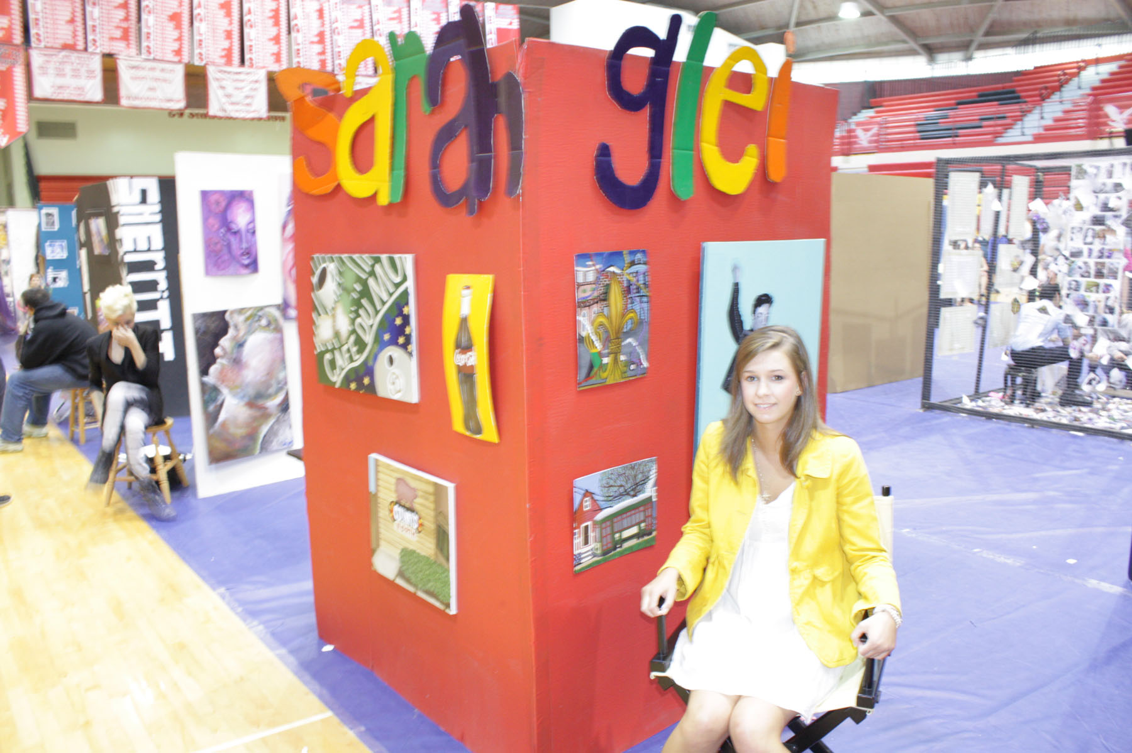

Slide 7
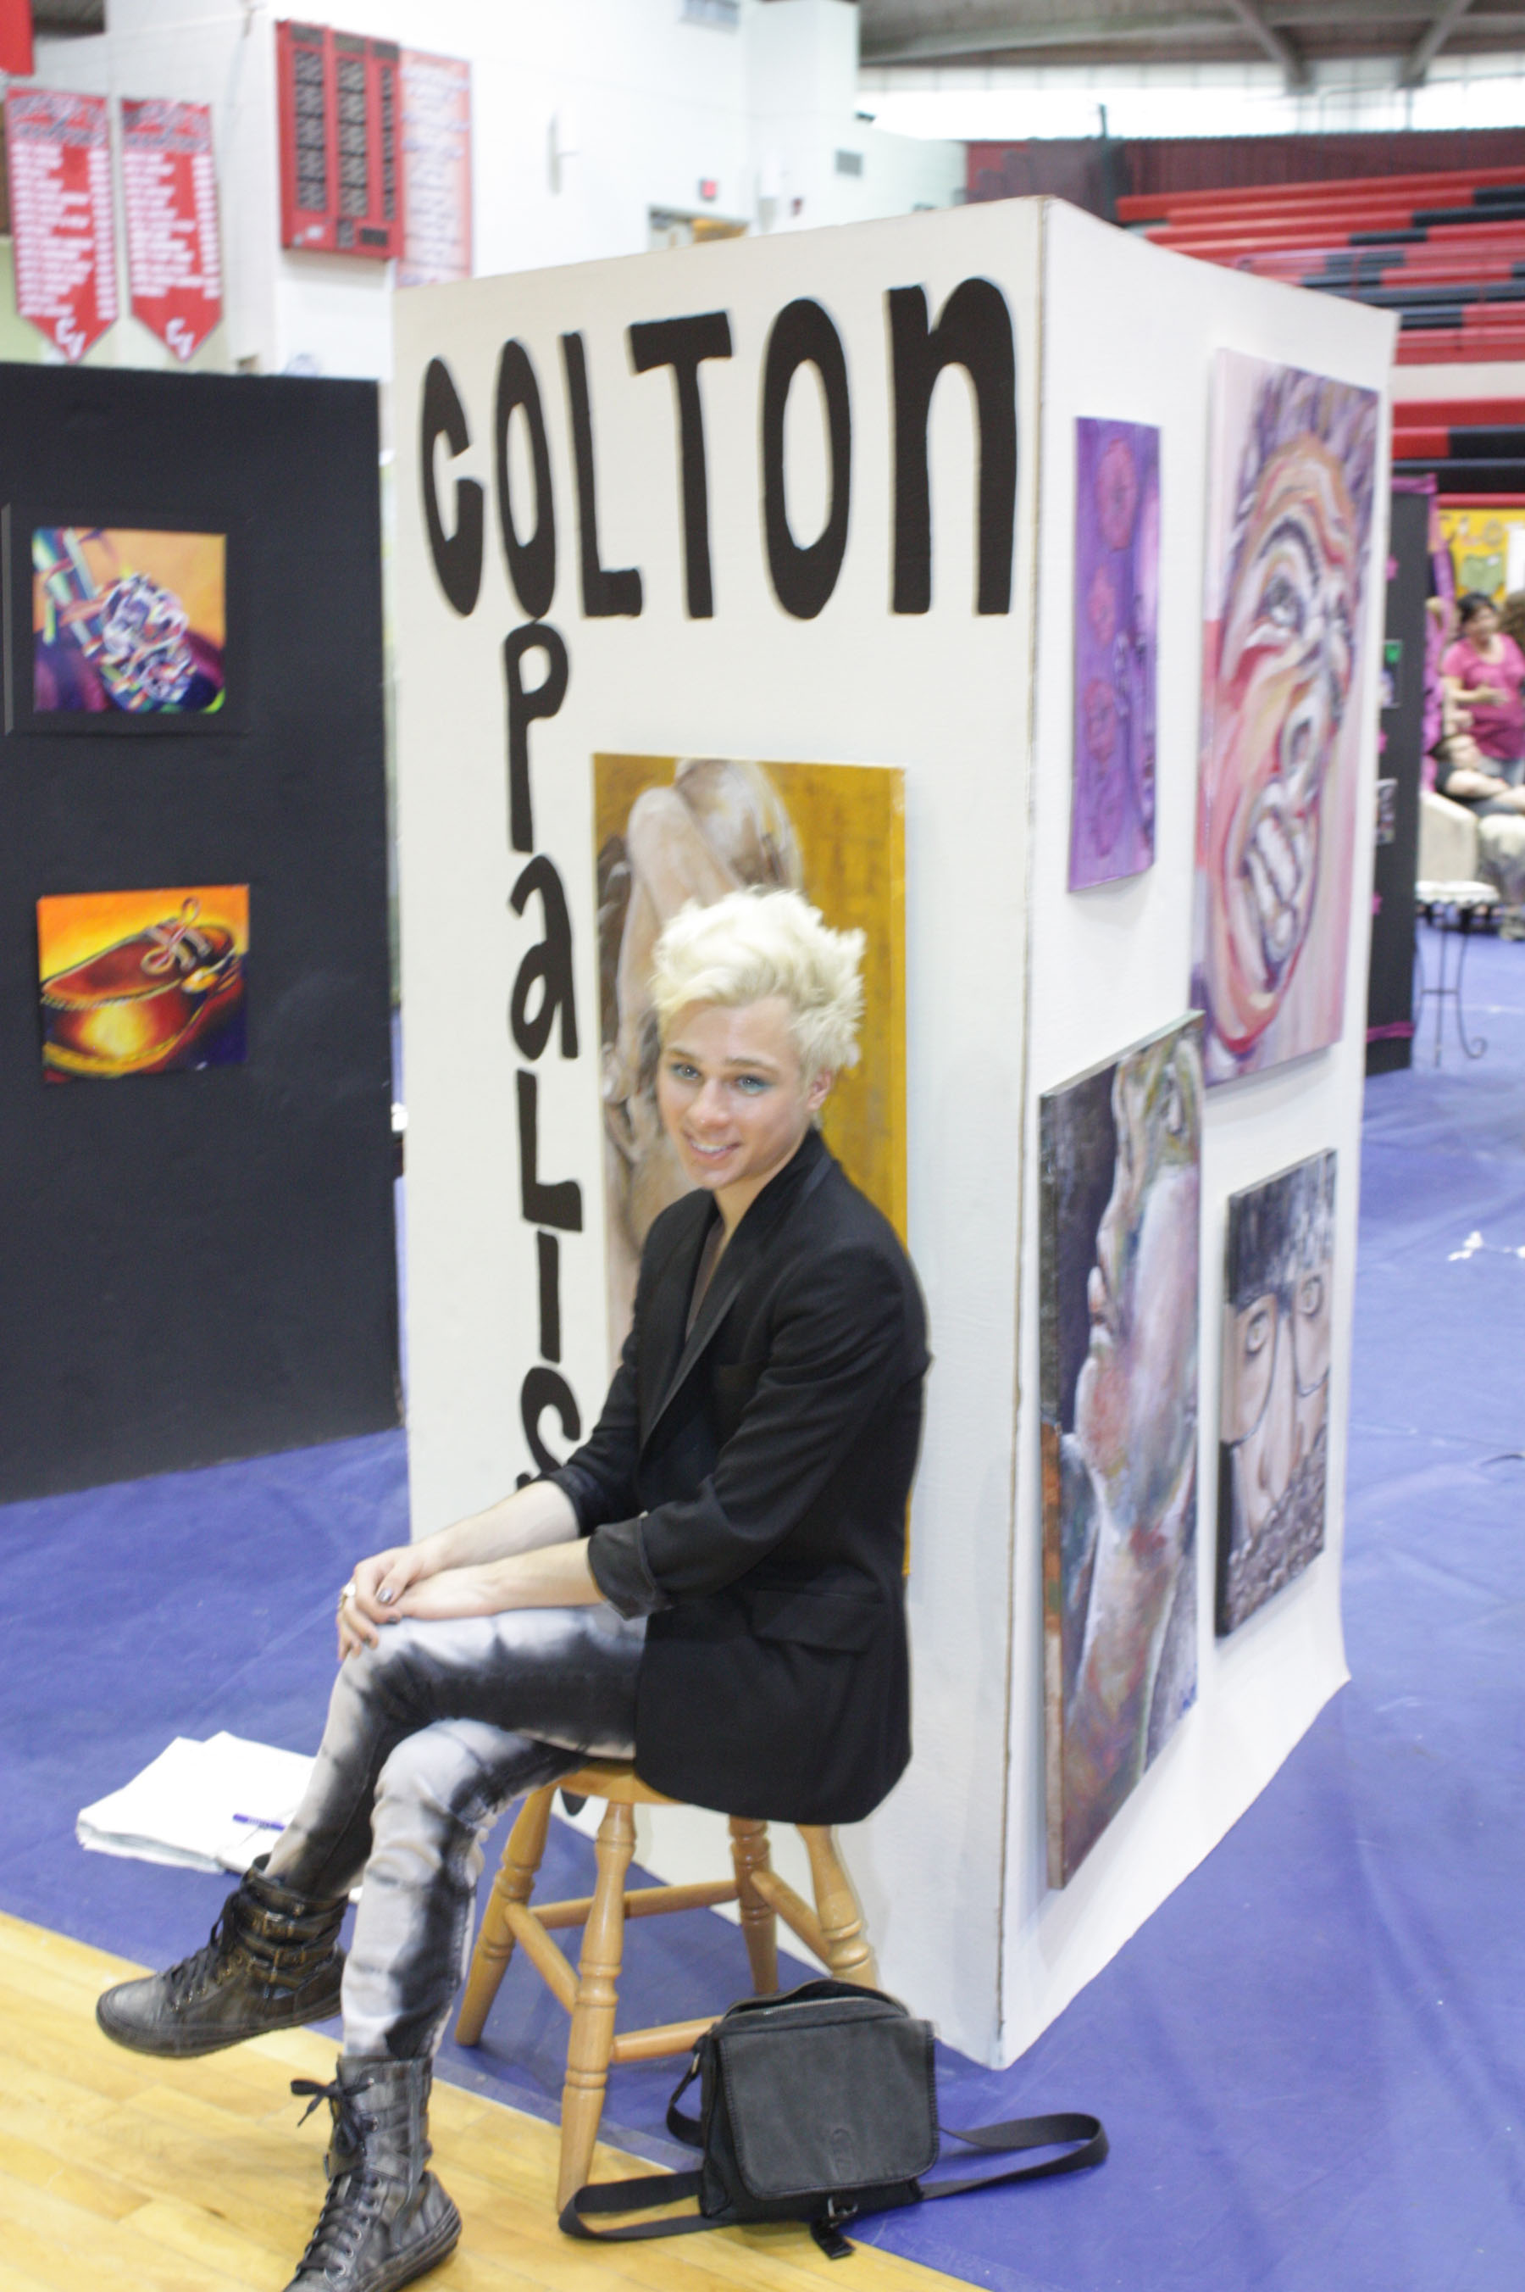

Slide 8
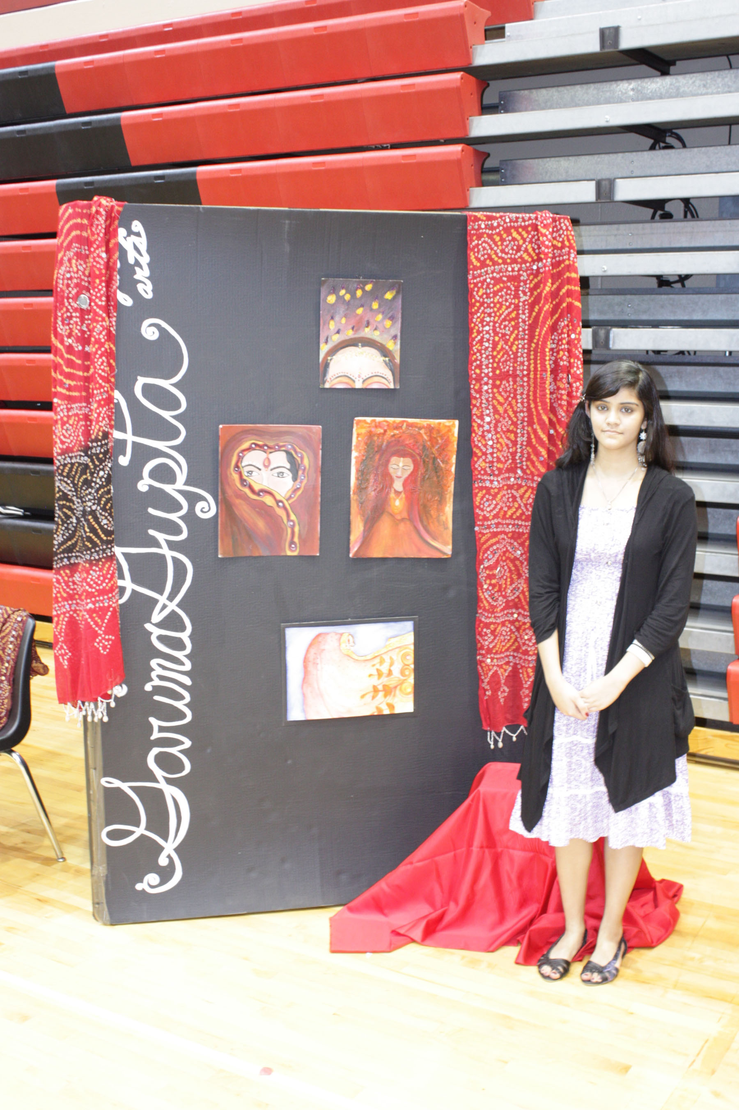

Slide 9
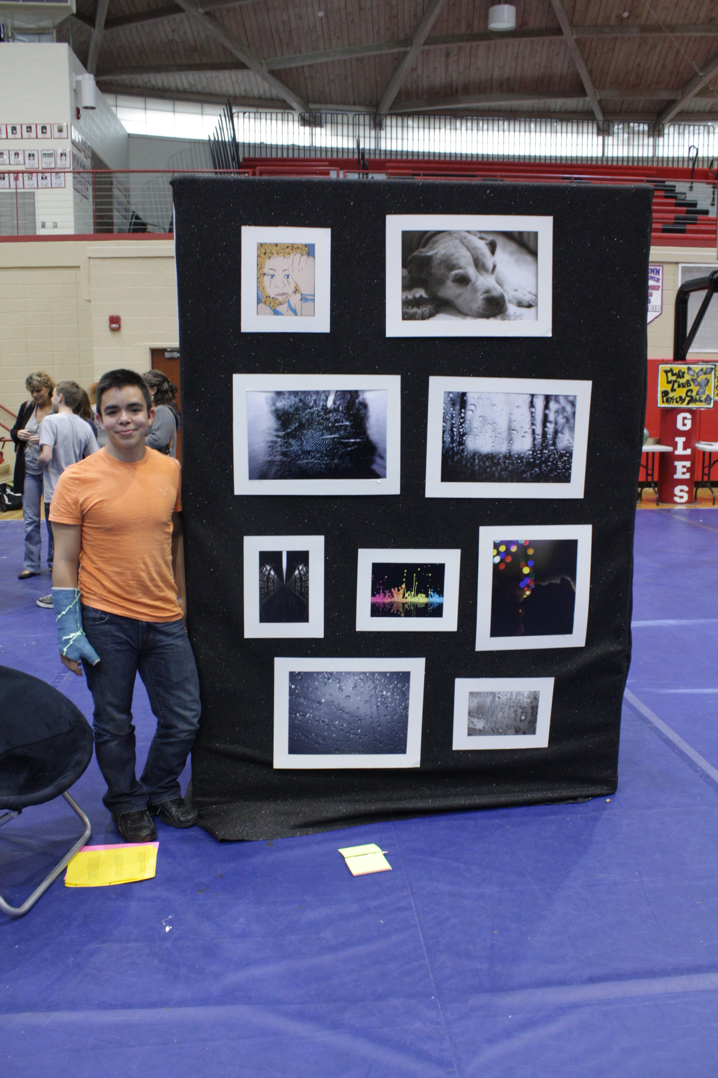

Slide 10
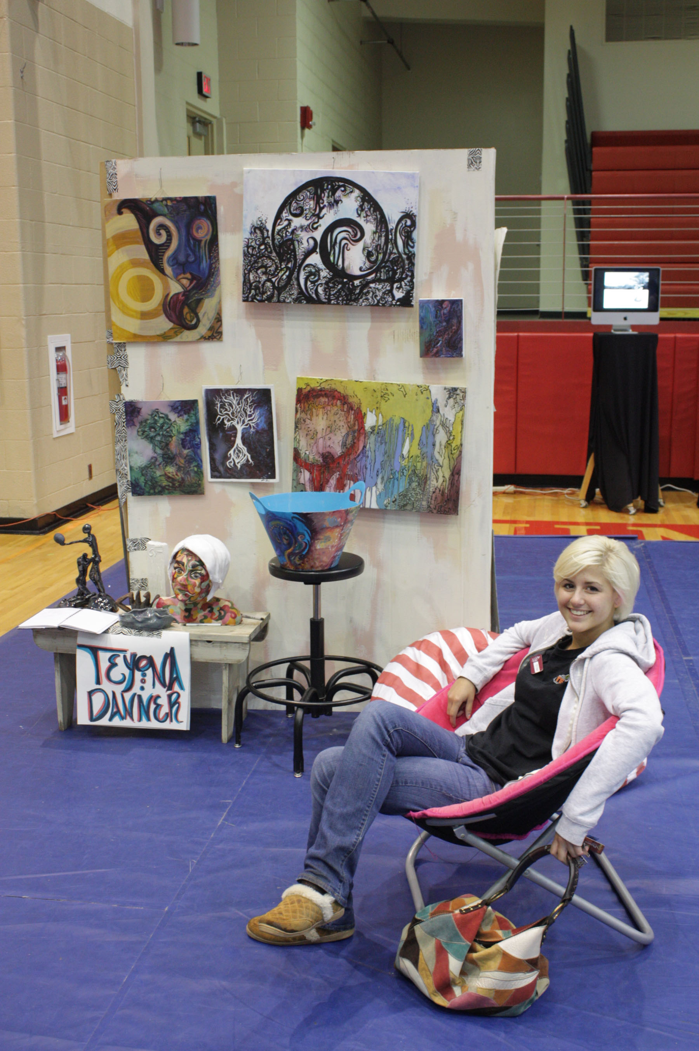

Slide 11
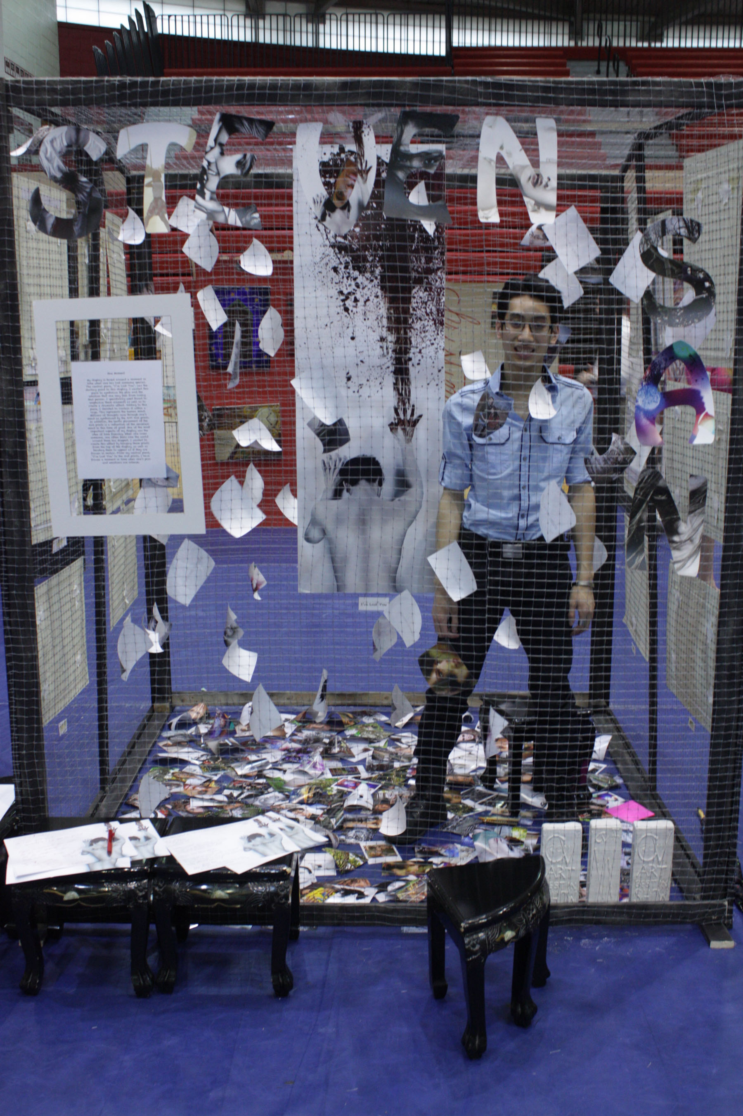

Slide 12
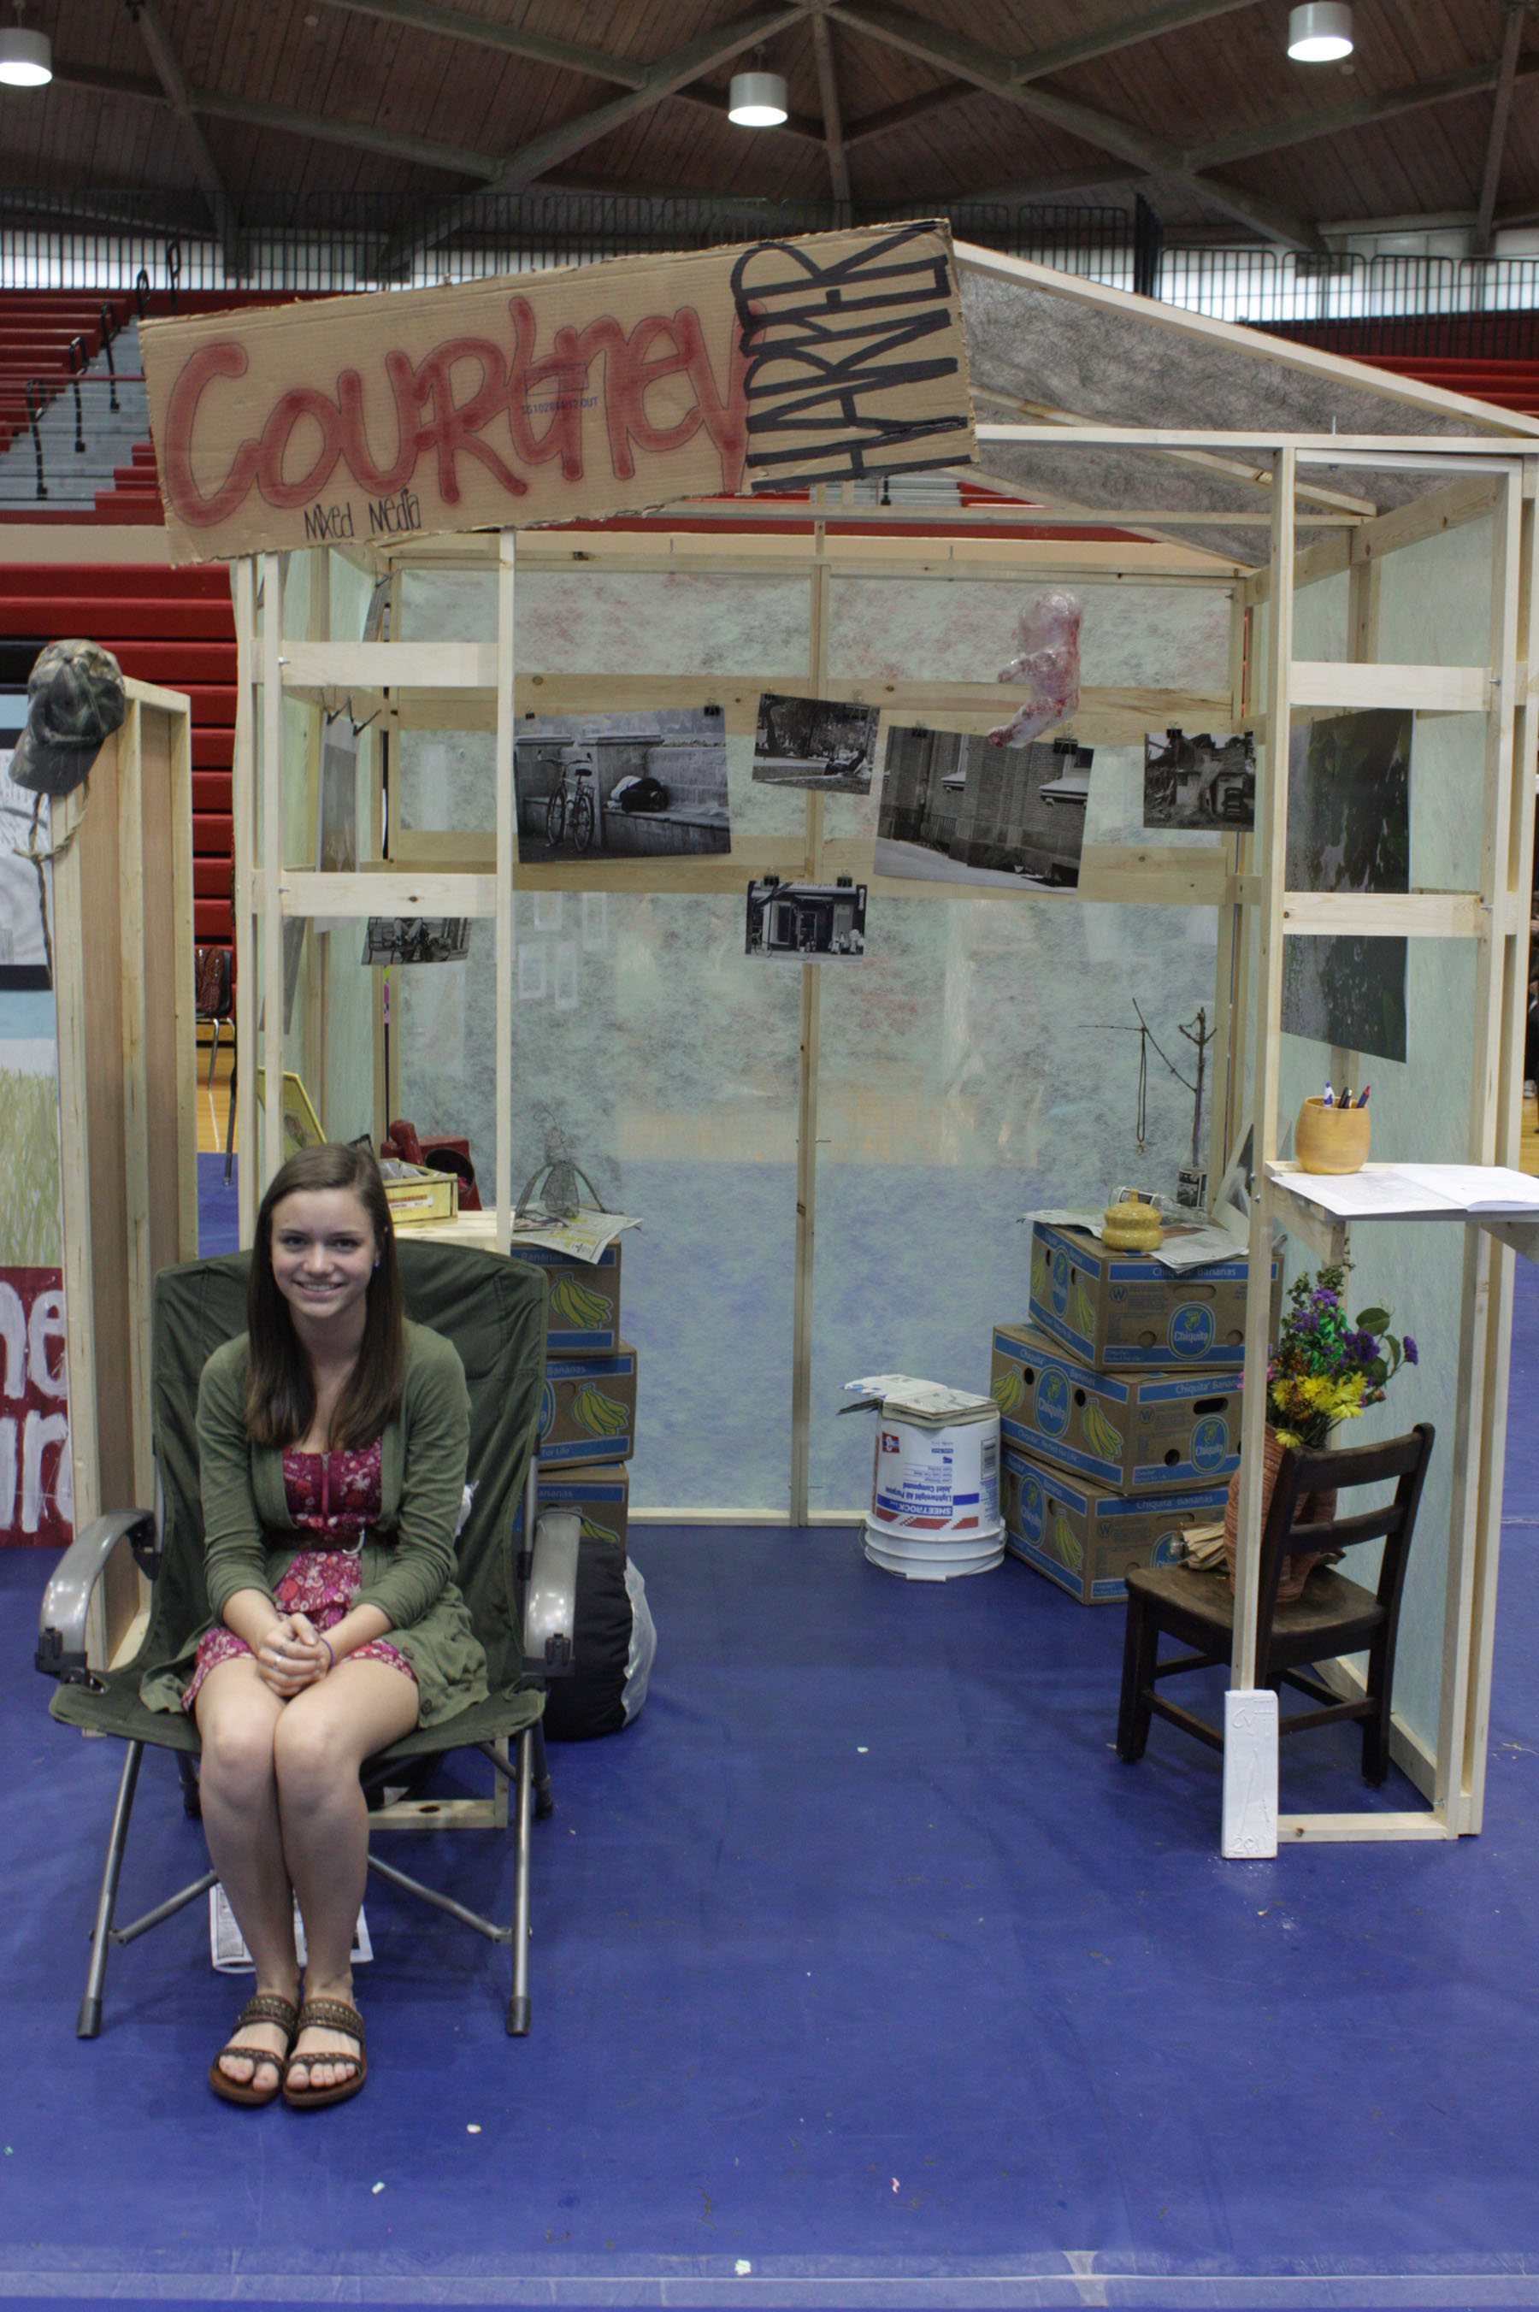

Slide 13
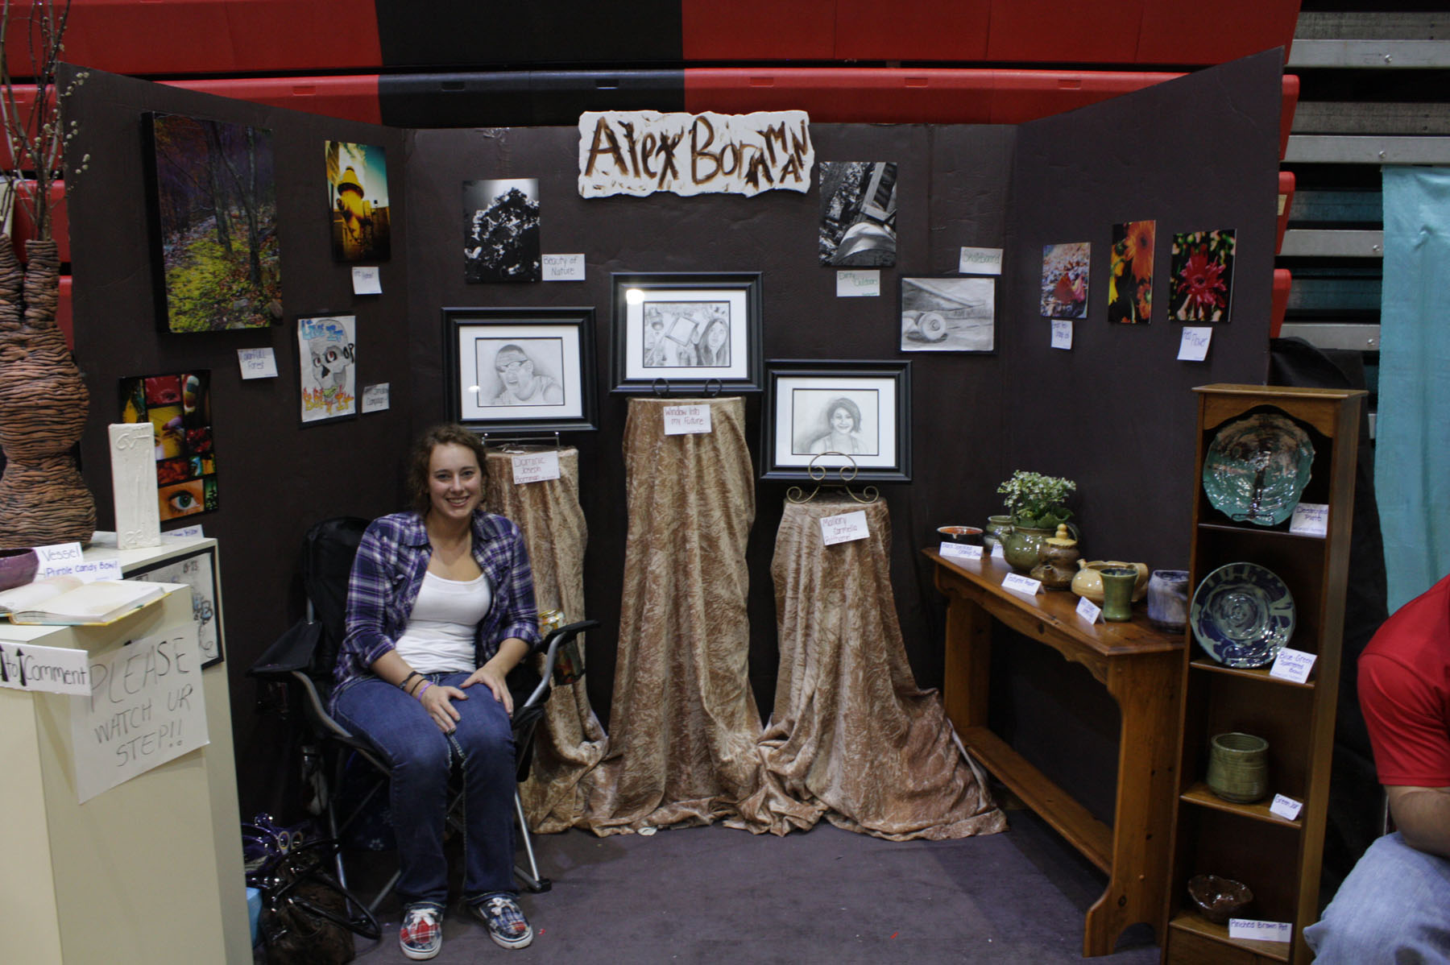

Slide 15
Exhibition Display: Highlighting Your Art
PERSONALITY NOT CLUTTER
You can include other materials in your display to give it personality…
You could drape fabric
Create display boxes of risers for a floor display
Bring in furniture or props
Since the cardboard will be one solid color, use these addition materials that you can provide to liven up your space!
Talk to your art teacher to discuss more options as you develop your sketches and plan for your space.
REMEMBER: Develop a clean, unified space to showcase your work

Slide 16
Execution
Take measurements of your work to determine the size of the space you will need.
Create a sketch of your display including the work to be displayed.
This sketch will need to be checked by your teacher!!
Your display should have a label which relates to your work…Fine Arts, Ceramics, Mixed Portfolio,etc.
Inventory your work: Keep a list of the pieces and measurements for planning and accounting purposes
Make labels for your work: Title and Class they were produced in

Slide 17
Restrictions (The No No’s)
No inappropriate work in or on the display…if you feel a piece is questionable please ask prior to setup.
No music in the display area
No candles or incense
No sitting or congregating in the display areas
No food or drinks are allowed in the gymnasiums…this is to protect your work, so please set a good example.
Nothing against school policies

